Slide 1
Personalized Yelp Recommendations
GA Tech CSE6424 Data Visualization - Team Project
Brandon Tran
John Hermina
Timothy Marx

Slide 2





About - Me
Education
Biochemical Engineering (2015)
Masters in Analytics (2020)
Work Experience
Virology Research (1.5 years)
Process Engineer II (1.0 years)
Process Scientist I (2.75 years)
Consultant (2 mo)

Slide 3
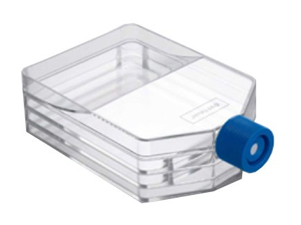
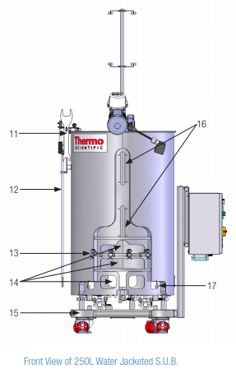
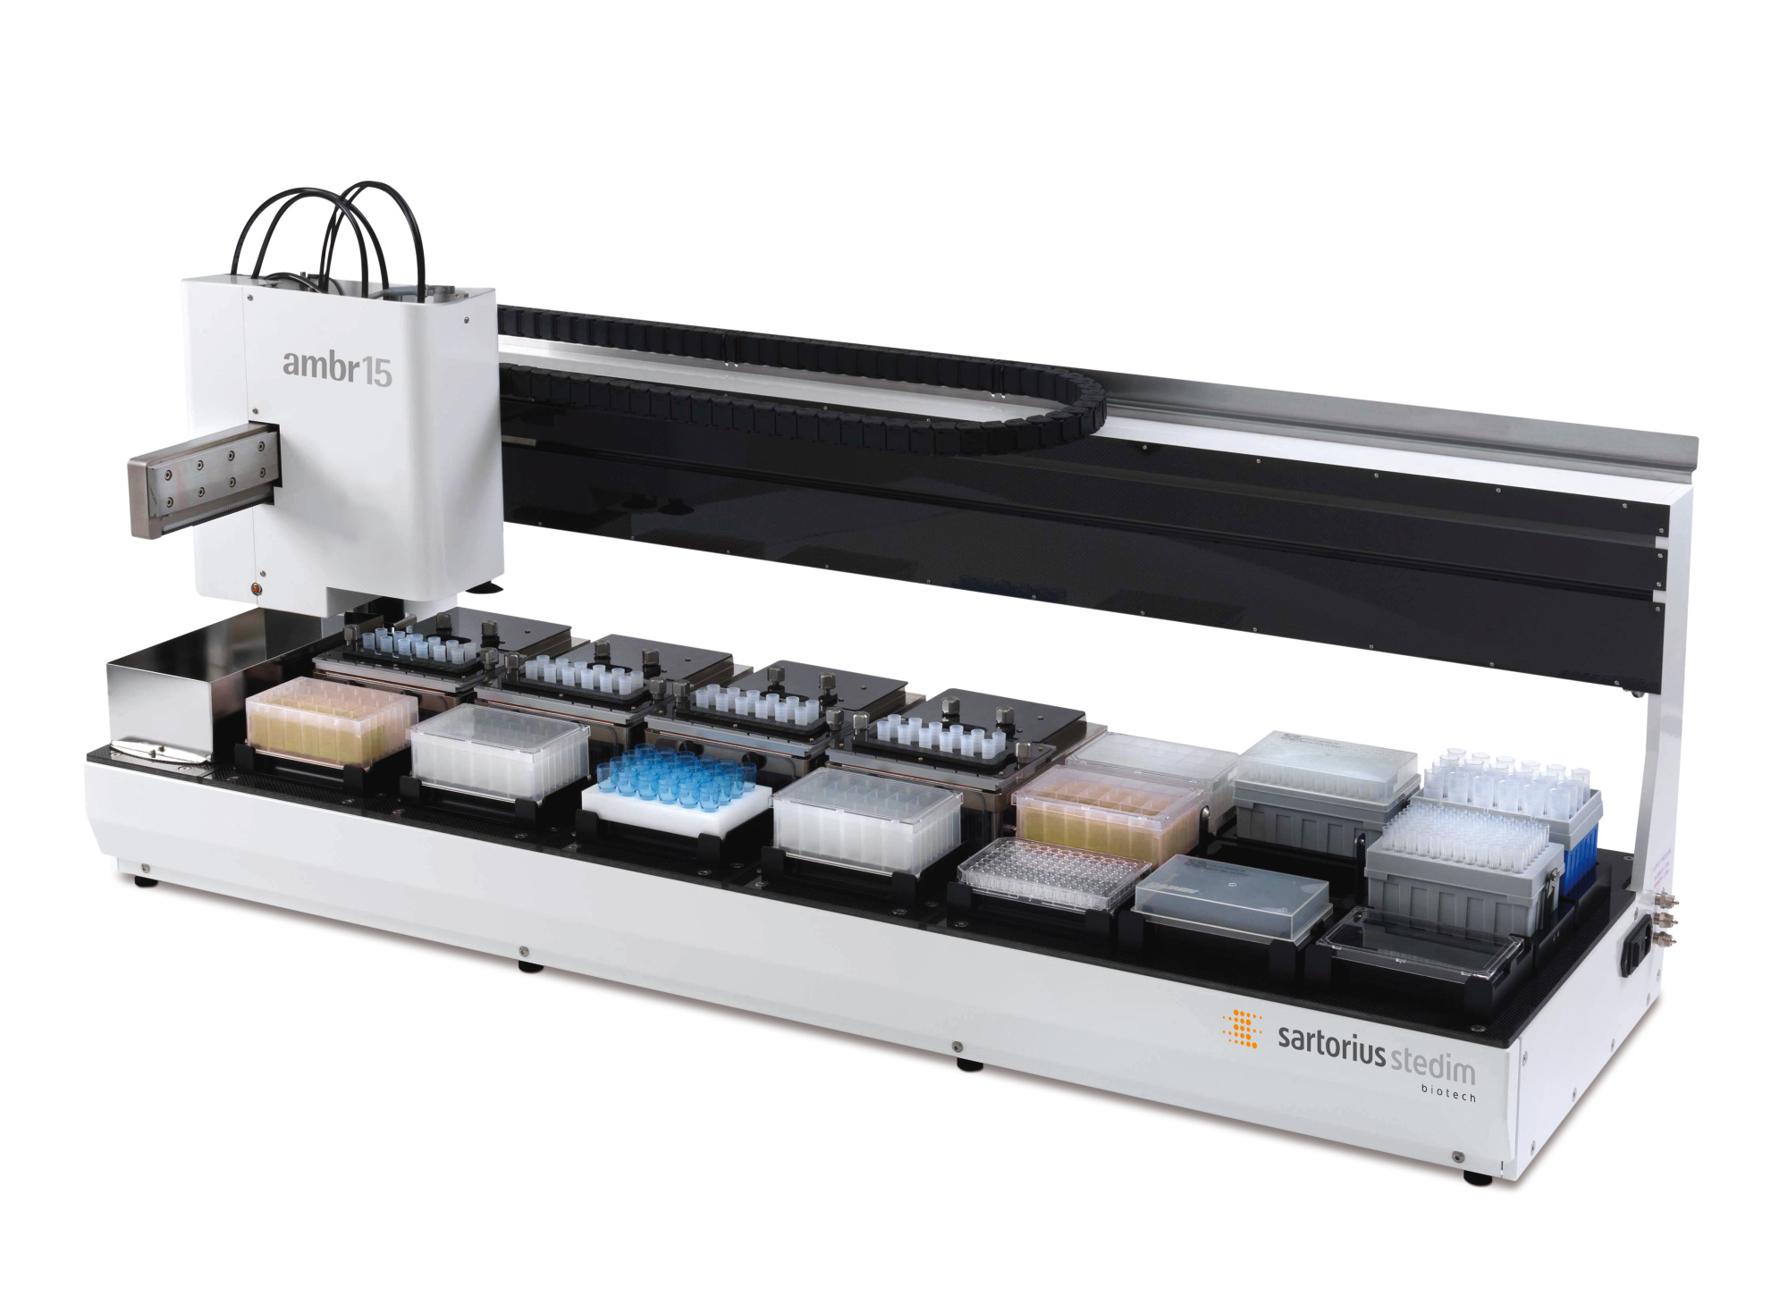








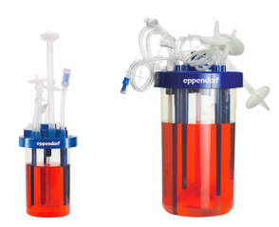
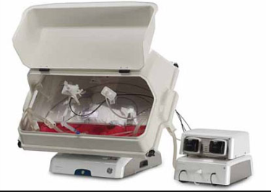



About – Software/Hardware & Programming Experience
Equipment (5-layer flasks, Ambr15, Waves, Stainless Steel reactors, disposable reactors)
Software
Programming

Slide 4
Problem Statement
Yelp is a great resource for finding places to eat!
However, unless you’re an avid Yelp user -- Yelp cannot recommend a personalized search.
Multiple written multiple reviews,
Multiple business visits/ratings
Heck, Yelp’s Recommendations go on for pages and pages like google searches!
This isn’t personalization more than just recommendations!

Slide 5
Project Goal
Create an app that can allow users to input their food preferences & output a personalized restaurant search
Additionally, provide metrics & limit the results as to allow users to make informed decisions quicker and with confidence!

Slide 6
Recommendation System Details
Package: LightFM
LightFM maps user/item features and performs dimensionality reduction to find latent factors (see Matrix Factorization) that exist in your model
The model of choice here was a user-based collaborative filtering model
A method that exploits user’s features (cuisine preference) to create a model that can be used to predict for a new user (you!) based on their own preferences

Slide 7
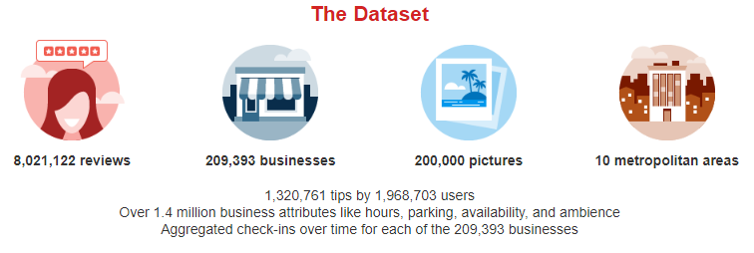
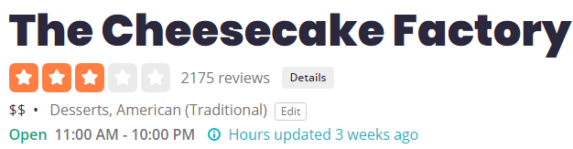
What exactly are the inputs? How was the model trained?
The Yelp Challenge Dataset contains lots of information
Specifically, we used what the business tagged itself as
Ex: The Cheesecake Factory lists under {Desserts,American (Traditional)}
These business tags are used as inputs and the LightFM model is trained on what users that exist in the system that have reviewed +3 locations.
Recommended restaurants are populated based on highest similarity score

Slide 8
Example of how User-based Collaborative Filtering works (Next slide)

Slide 9
Model Input & Output Overview
User_profile = [“Japanese”,”Thai”,”Burgers”,”Korean”,”Soups”]
Feature Vector for this user:
“Japanese” | “Burgers” | “American (New)” | “Wigs” | “Thai” | …… | “Hair Salon”
1 | 1 | 0 | 0 | 1 | ….. | 0
Sparse Matrix{
Dim:1xN
Values: {(“Japanese”,1)
…
(“Soups”,1)
}
N = # unique features
Model.predict(users_id=0,
items_id=
user_features=
)
All_items = {0,1,2,…,M}
M = # businesses
Sparse Matrix{
Dim:1x402
Values: {(“Japanese”,1)
…
(“Soups”,1)}
Sort
All_items = {0,1,2,…,M}
M = # businesses
Top X recs
Notes:
def recommendations(user_profile):
return top_recommendations
A list object of this new user’s preferences is generated from our ProfileBuilder dropdown menu
This list object is then used to populate a feature vector that is a numpy.array([]) of dimensions [1xN] where N = number of unique features we found in our model (E.g: The unique number of business categories such as a Ramen shop being labeled [“Ramen”,”Japanese”,”Soups”,”Sushi”])
The feature vector is converted to a Sparse Matrix for LightFM model digestion
The model is then called with the following parameters:
“Users_Id = 0” is an index reference to the row of the user_features input (which is a 1xN vector --- it only has 1 row!)
“Items_id = all_items” is a numpy contiguous array from [0,1,2,…,M] where M is the number of businesses in our model – somewhere around 6000
“User_features = []” we feed in the sparse matrix generated in #3
num_threads is used to compute utilizing multiple cores if your python environment supports it
Lastly the results are then sorted from top to worst scores
Only the top 5 are extracted and fed back into the Dash App

Slide 10
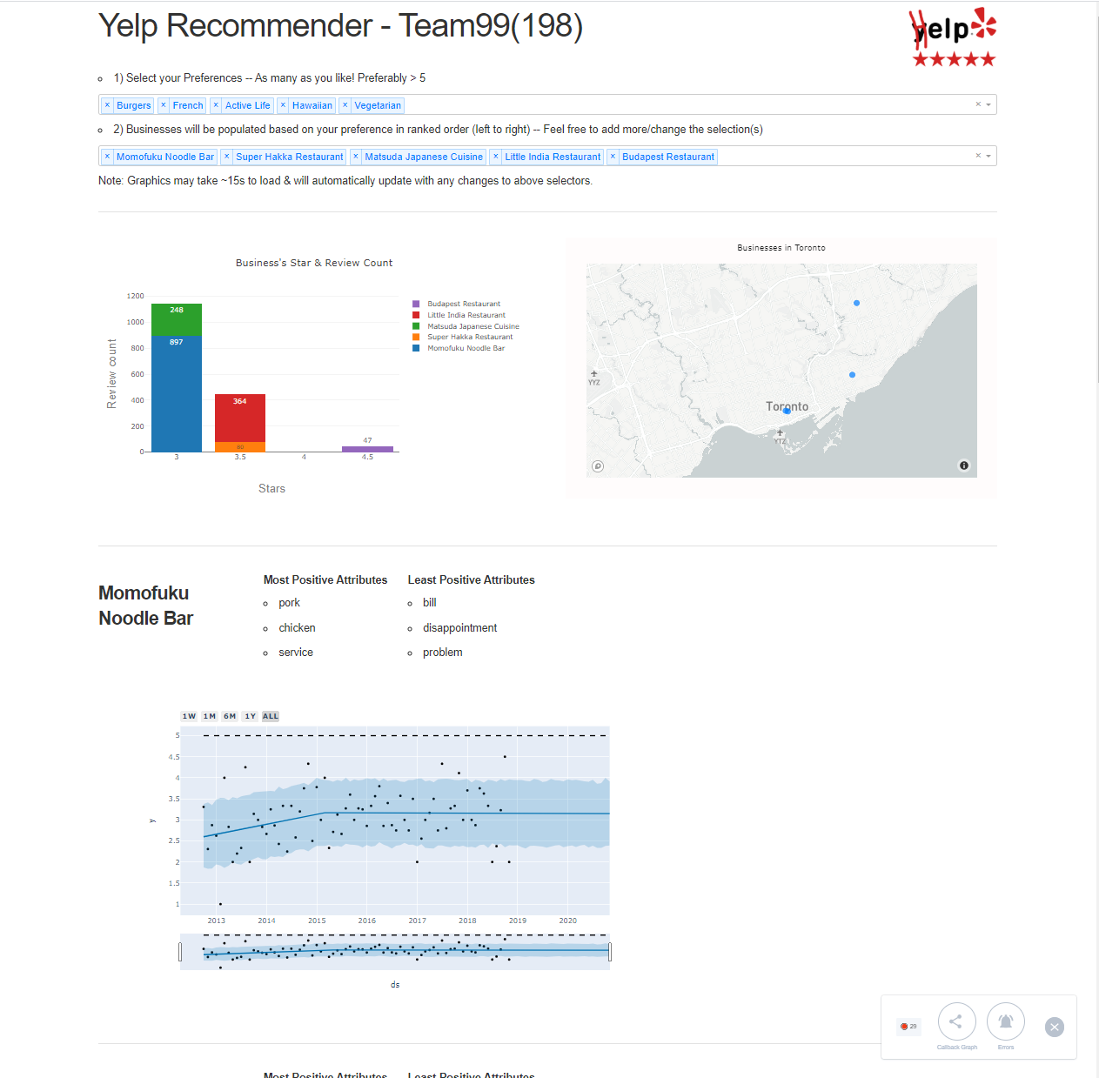
Putting it all together!
1) Preferences are fed into the model in the 1st drop-down menu
2) Recommendations are automatically populated from the LightFM model
3) Graphics are also automatically updated once businesses are populated

